Slide 1
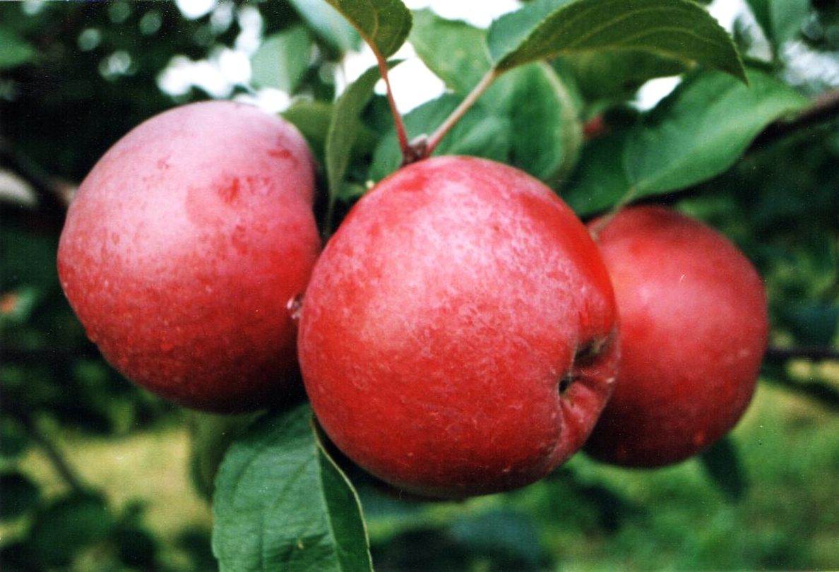
Project Ripe
Identifying and Promoting Products Ripe for Picking

Slide 2
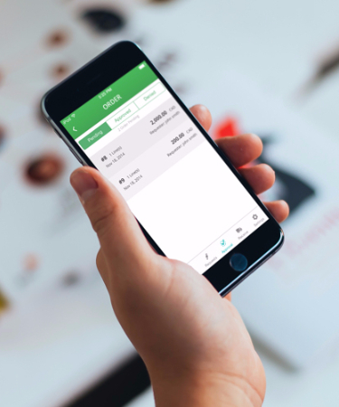
Project Ripe
Project Team
Fatima Mehdikarimi
Raj Kartha
Alejandra Gomez
Priya Kulkarni
Assam Javaid
Using machine learning to learn our customers’ preferences and promoting the right products at the right time

Slide 3
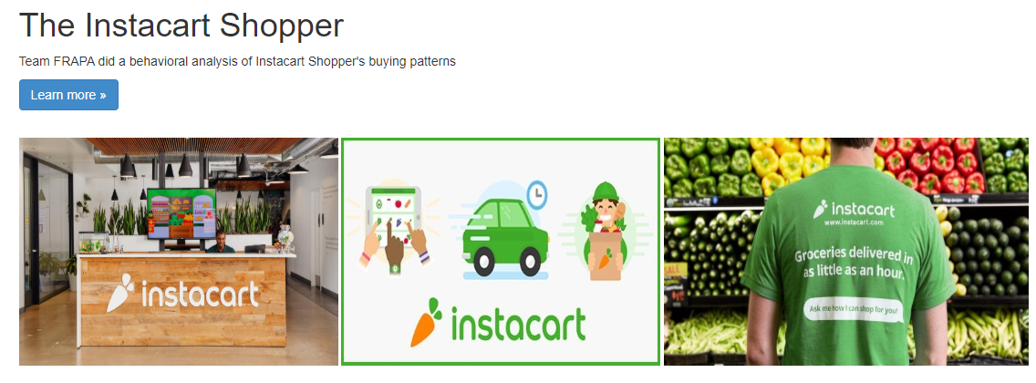
Information Hub

Slide 4
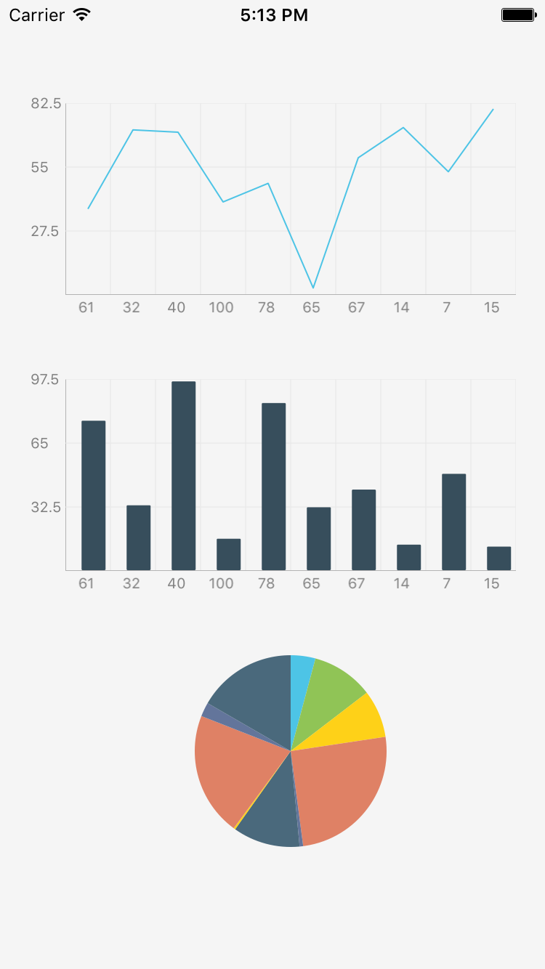
Our Data
Instacart Online Grocery Shopping Dataset
Over Three Million Grocery Orders
200,000+ Instacart users
50,000+ products
Dozens of product categories

Slide 5
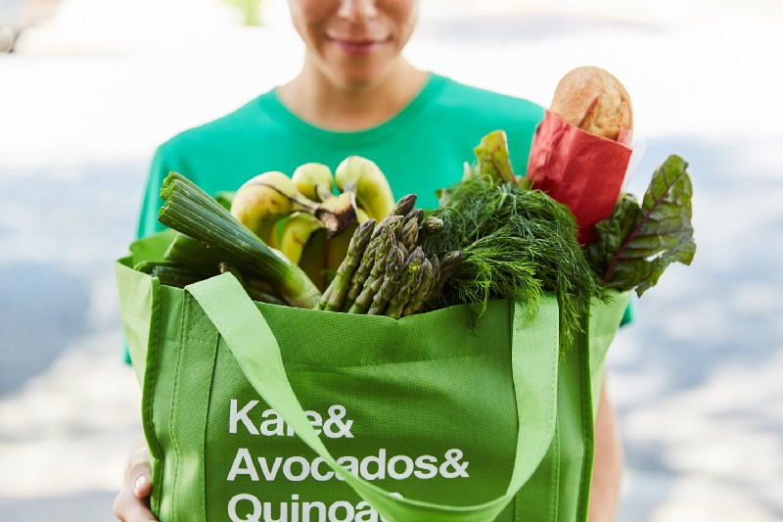
Our Learnings
Analysis of the Data

Slide 6
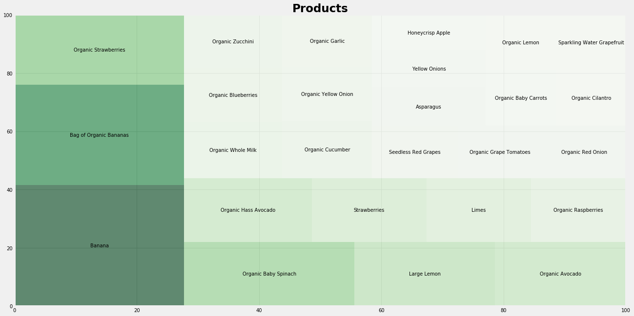
Product Data Analysis
Frequency of Top Items Ordered

Slide 7

Machine Learning
Our Process & Methodology

Slide 8
Market Basket Analysis
Apriori Algorithm
What is Market Basket Analysis?
Market Basket analysis looks for the frequently co-occurring combinations of items that are bought together.
ML Library used: Mlxtend (Apriori Algorithm & Association Rules)
What are Association Rules?
Each rule is the result basket set of our Apriori Algorithm.
A rule is a group of items frequently bought together. They are the output of our model.

Slide 9
Association rules
If (antecedent)-> Then (consequent) relationship
A(antecedent)={paper,pencil} -> B(consequent) ={eraser}
Support gives the fraction of transactions which contains item A and B
Support = freq (A,B) / n
Confidence is the probability that a transaction that contains pencil and paper also contains eraser.
Confidence (A->B) = Support (A,B) / support (A)
Lift summaries the strength of association between the item sets.
Lift = support(A,B)/ (support(A)*support (B)

Slide 10
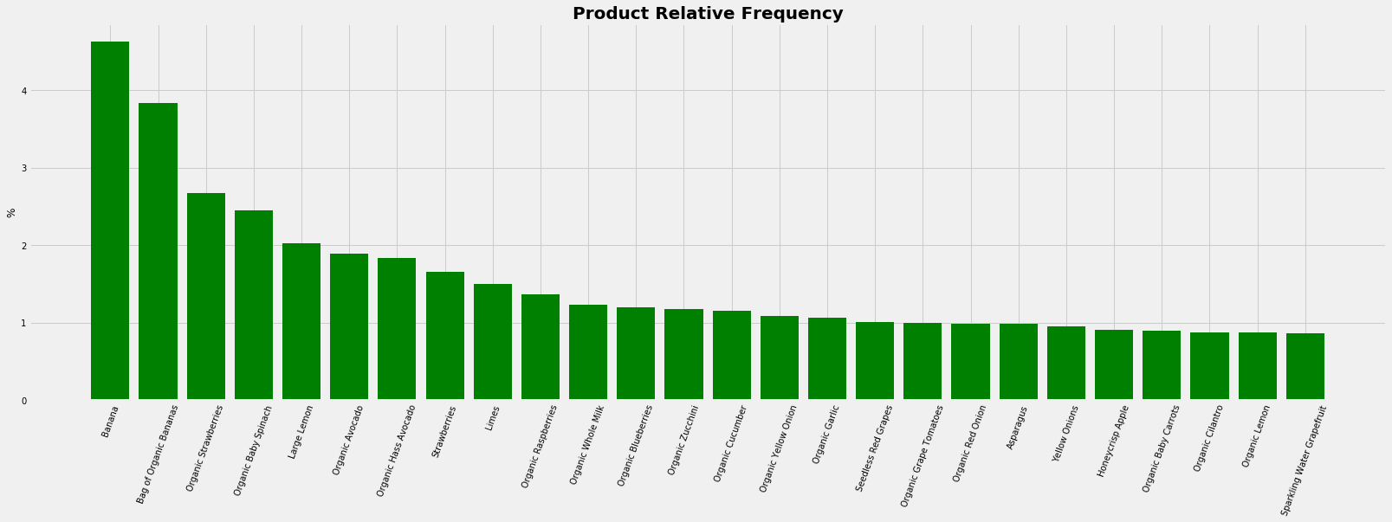
Product Data Analysis
Relative Frequency of Top Items Ordered

Slide 11
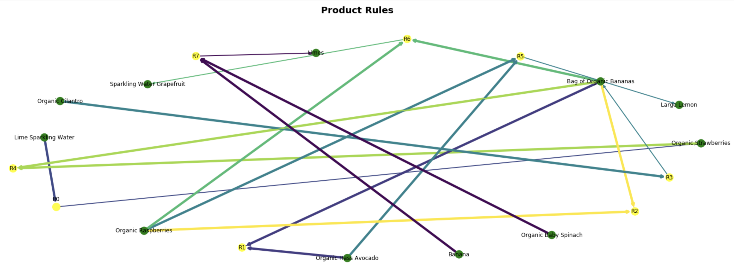
Apriori Algorithm Output
Association Rules

Slide 12
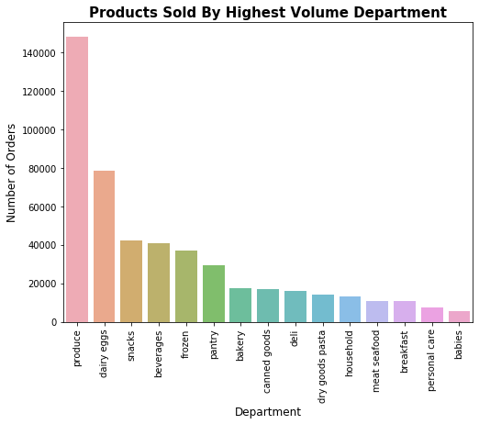
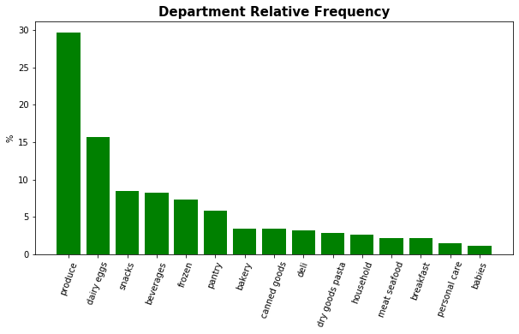
Information Hub
Department Frequency Analysis

Slide 13
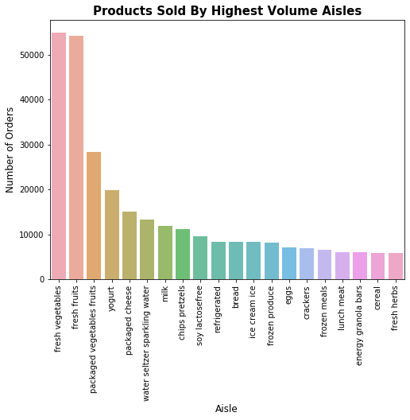
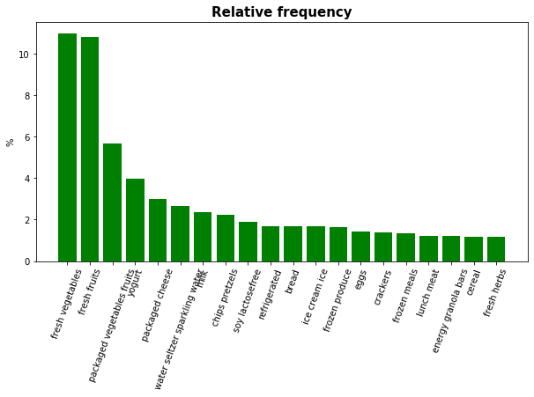
Information Hub
Aisle Frequency Analysis

Slide 14
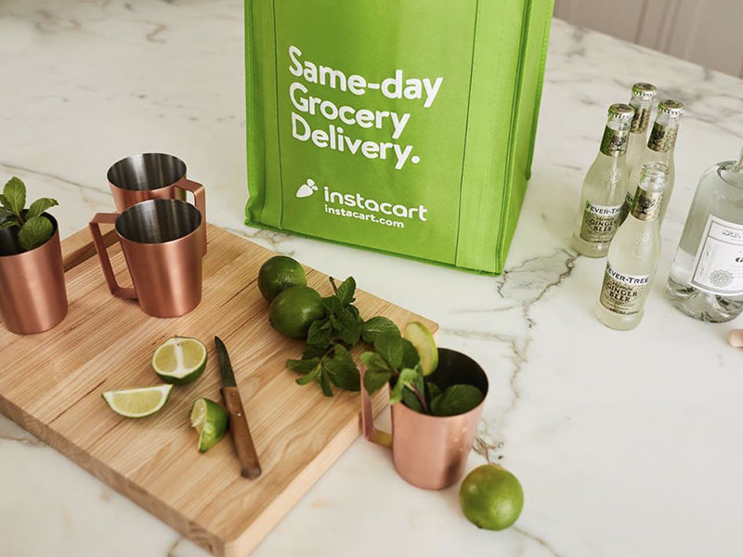
Recommendation
Our Recipe for Success

Slide 15
Increasing Basket Size
How to increase incremental order size
Promote (Offer)
Don’t Forget (Product Placement)
Focus on Confidence
Time communications to weekends
Promote products with dark green that showcase smaller confidence levels with individualized promotions to increase sales
Organic Strawberries & Box of Organic Bananas --> Organic Raspberries
Organic Strawberries & Box of Organic Bananas --> Organic Hass Avocado
Focus on Lift
Don’t spend marketing dollars promoting products that have a yellow lift that showcase higher likelihood of being ordered
Instead place products near each other in website design and remind shoppers in cart to order
Lime Sparkling Water —> Sparkling Water Grapefruit

Slide 16
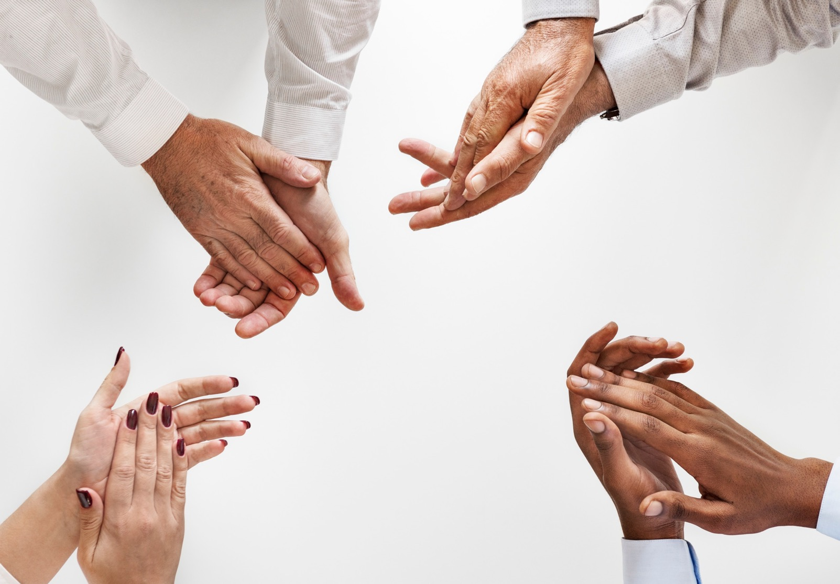
Thank You

